Slide 1
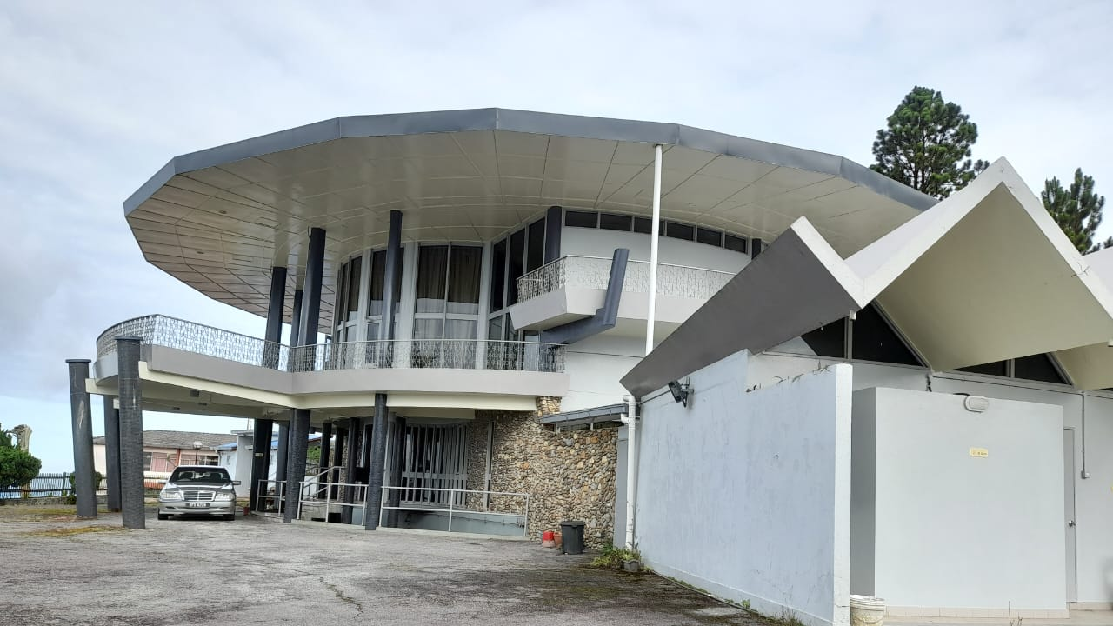
National
Prayer Altar
@ Peacehaven,
Genting Highlands

Slide 2
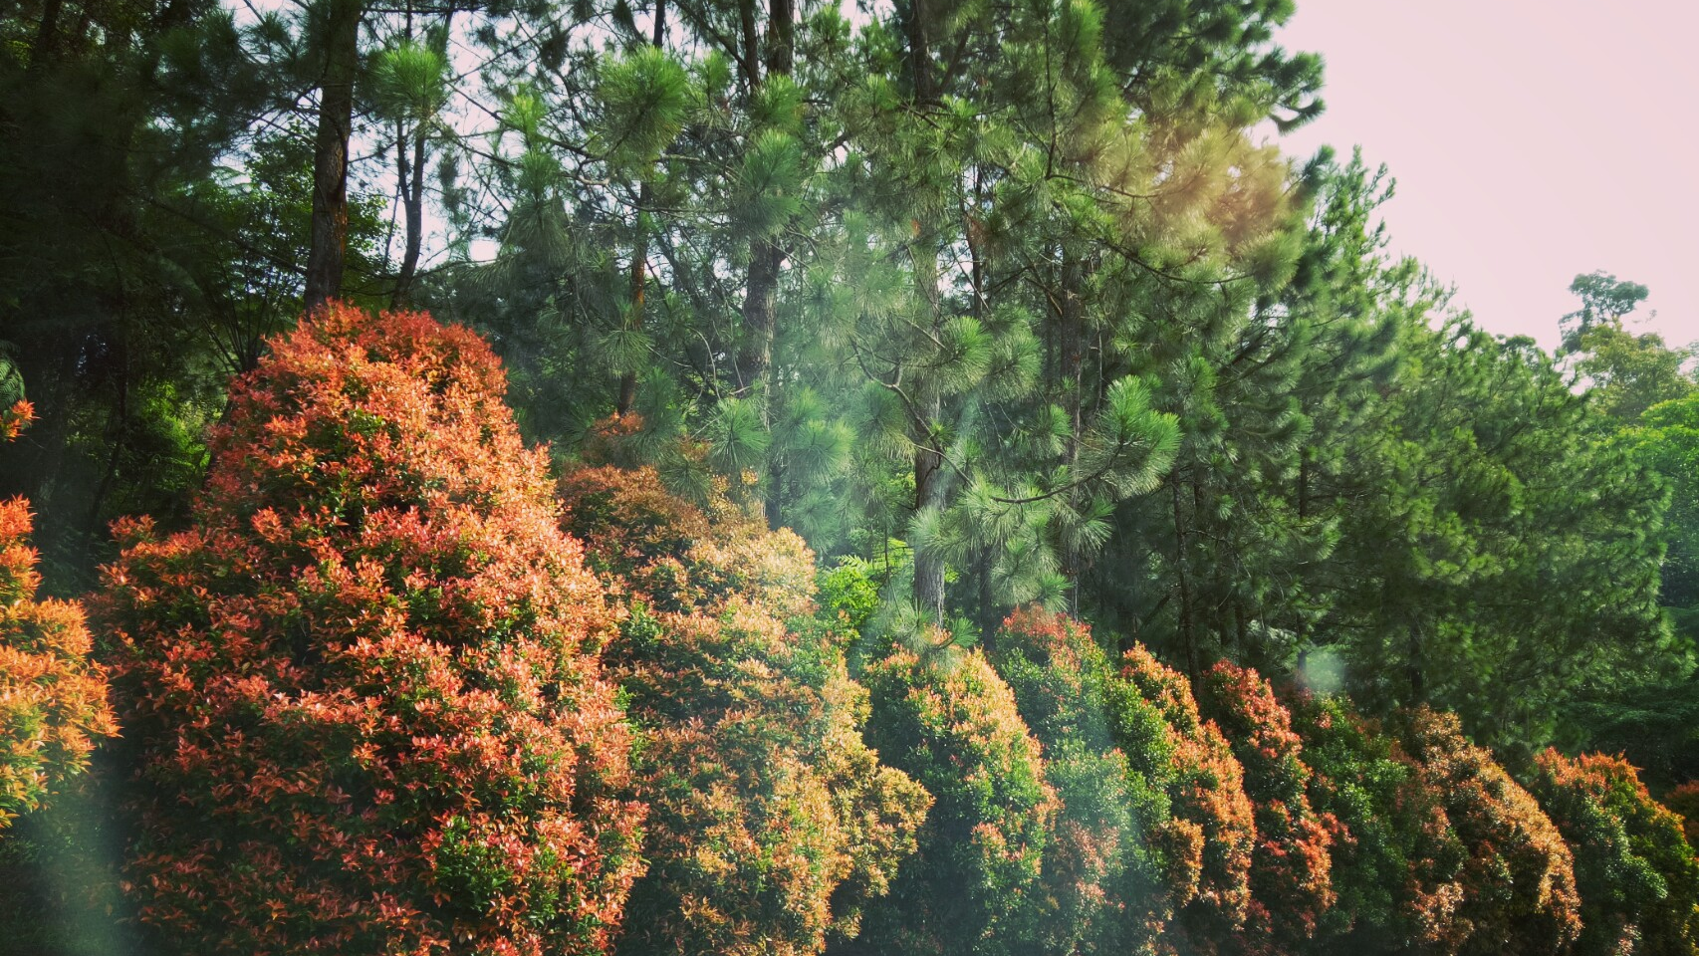
Come and let us go up to the mountain of the Lord. (Micah 4:2)

Slide 3
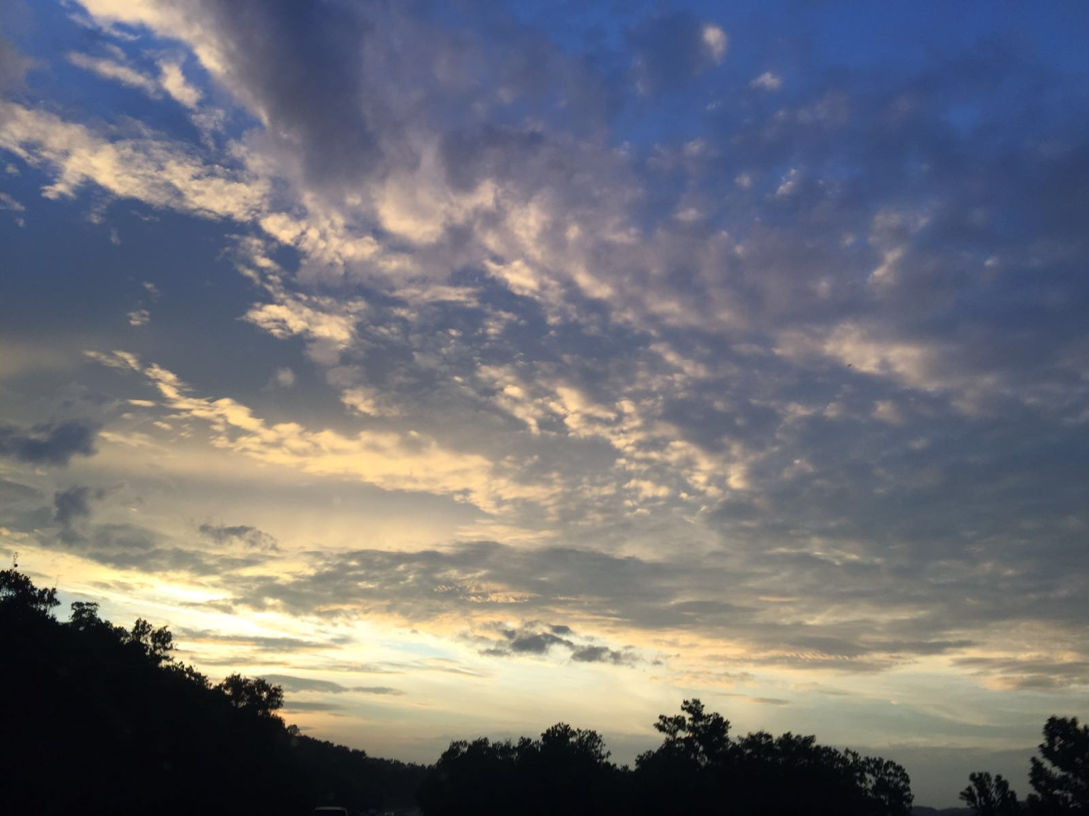
Build the National Prayer Altar as a National Church
Contribute a day/trip yearly.
Pray for the Welfare of the Nation as the Body of Christ.

Slide 4
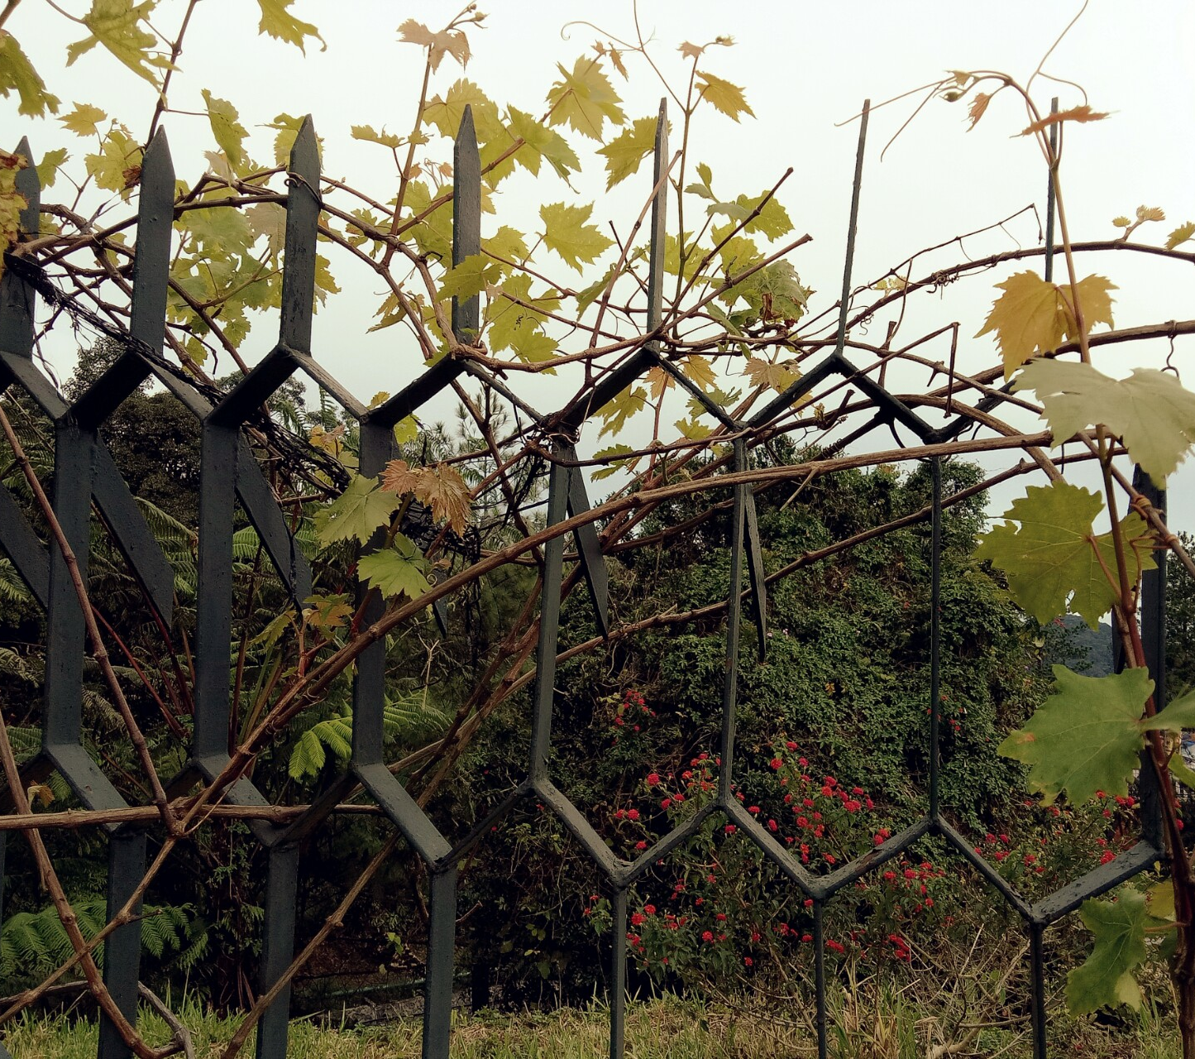
Who are encouraged to go?
Churches under NECF who are our partners to transform the nation.
Non-NECF churches who want to be part of our prayer-partners for the nation.
Pastors Fellowship Groups, especially those in Klang Valley
Home/prayer groups

Slide 5
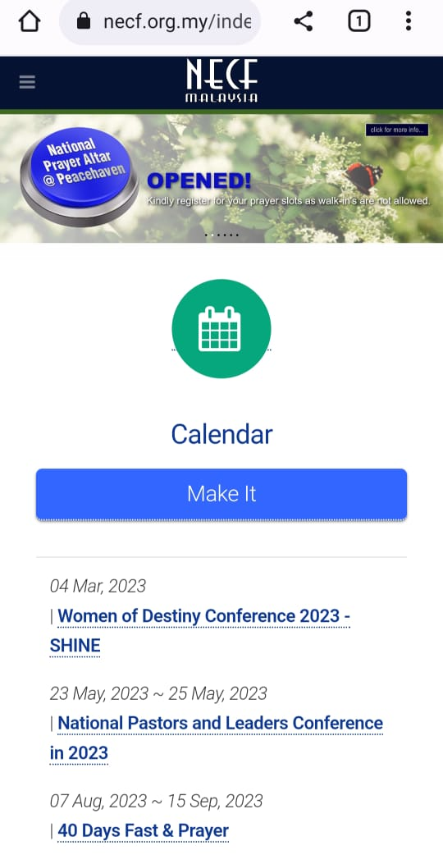

How to register?
Go to NECF's website and look for the banner with the blue button as shown.
Click the button and follow the links to check availability of prayer slots and register your slots.

Slide 6
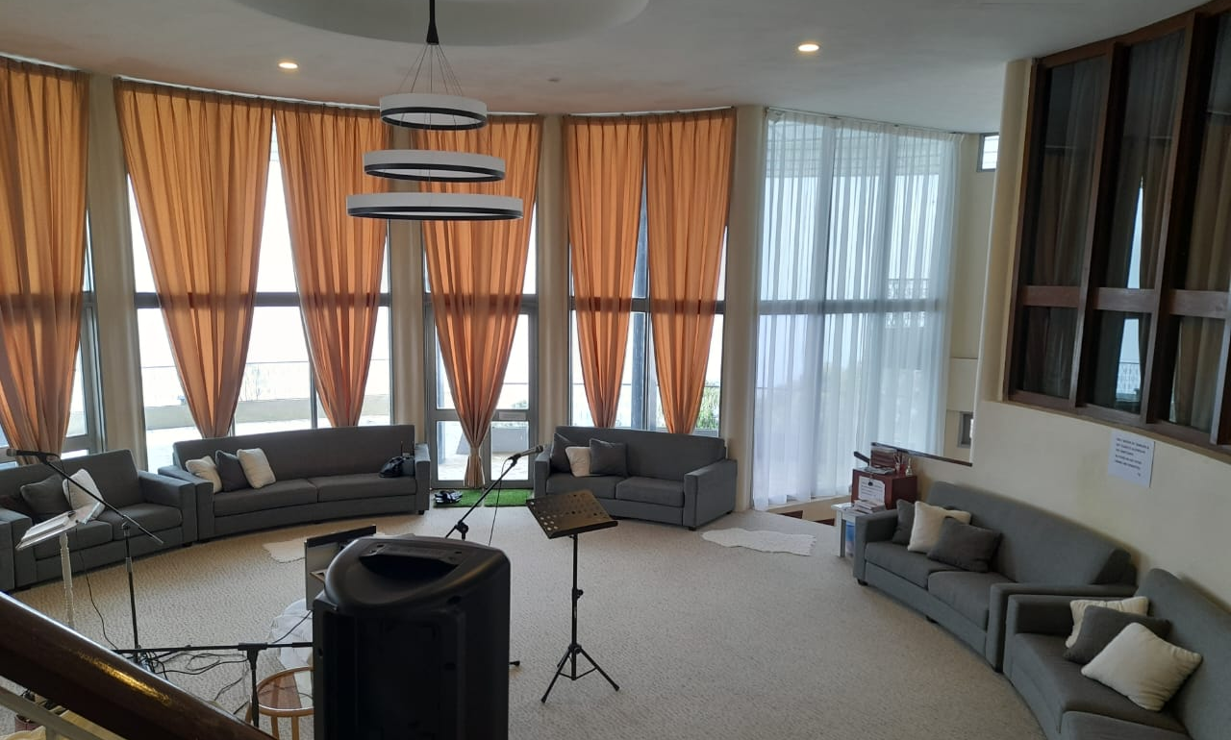
Prayer Altar @ Bungalow, Peacehaven
The sanctuary in Bungalow can accommodate about 30 people.
It is equipped with simple PA & musical instruments.

Slide 7
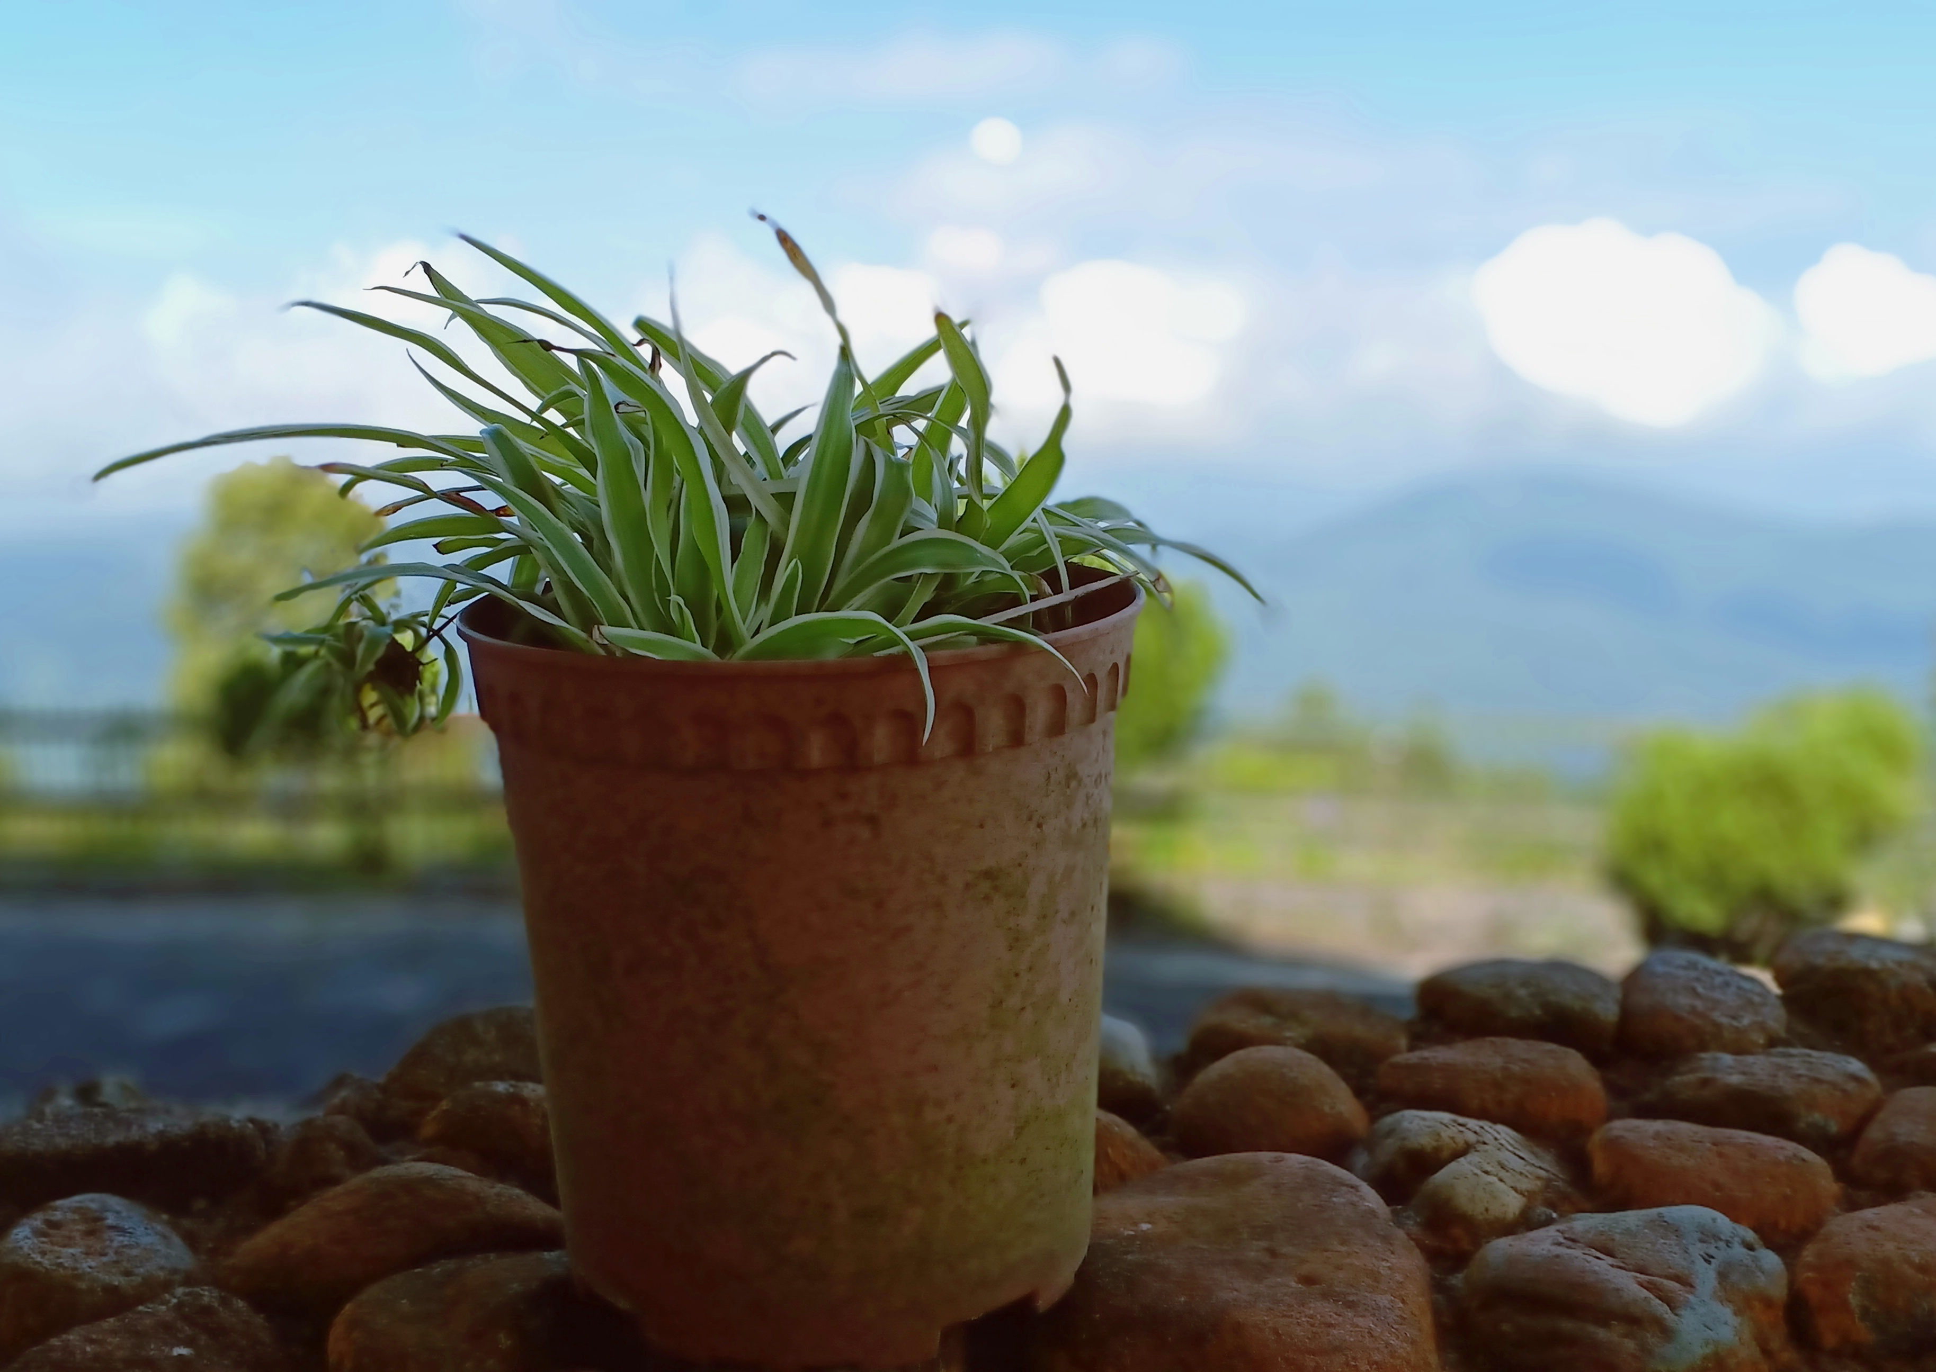
Prayer Altar @ Bungalow, Peacehaven
Facilities:
The accommodation at the bungalow is FOC.
Free will offering is most welcome! The offering box is available at the sanctuary.

Slide 8
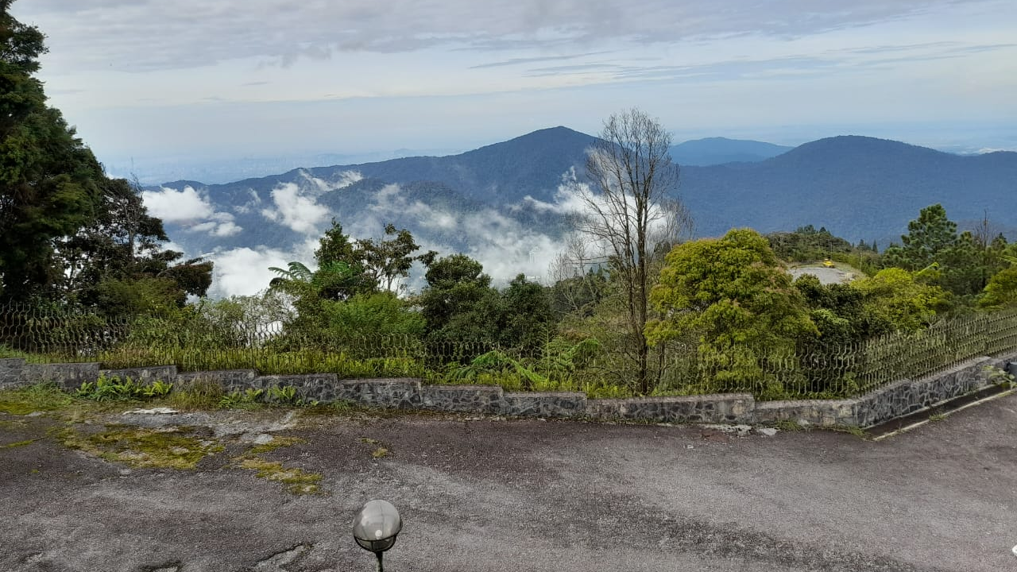
Prayer Altar @ Bungalow, Peacehaven
Rooms available:
2 annexed rooms (each can house 2 persons) for (4) pastors who stay overnight.
3 rooms which could accommodate around 10 people.
Additional rooms (by request) at campsite is RM50 per room (4 persons) per night.

Slide 9
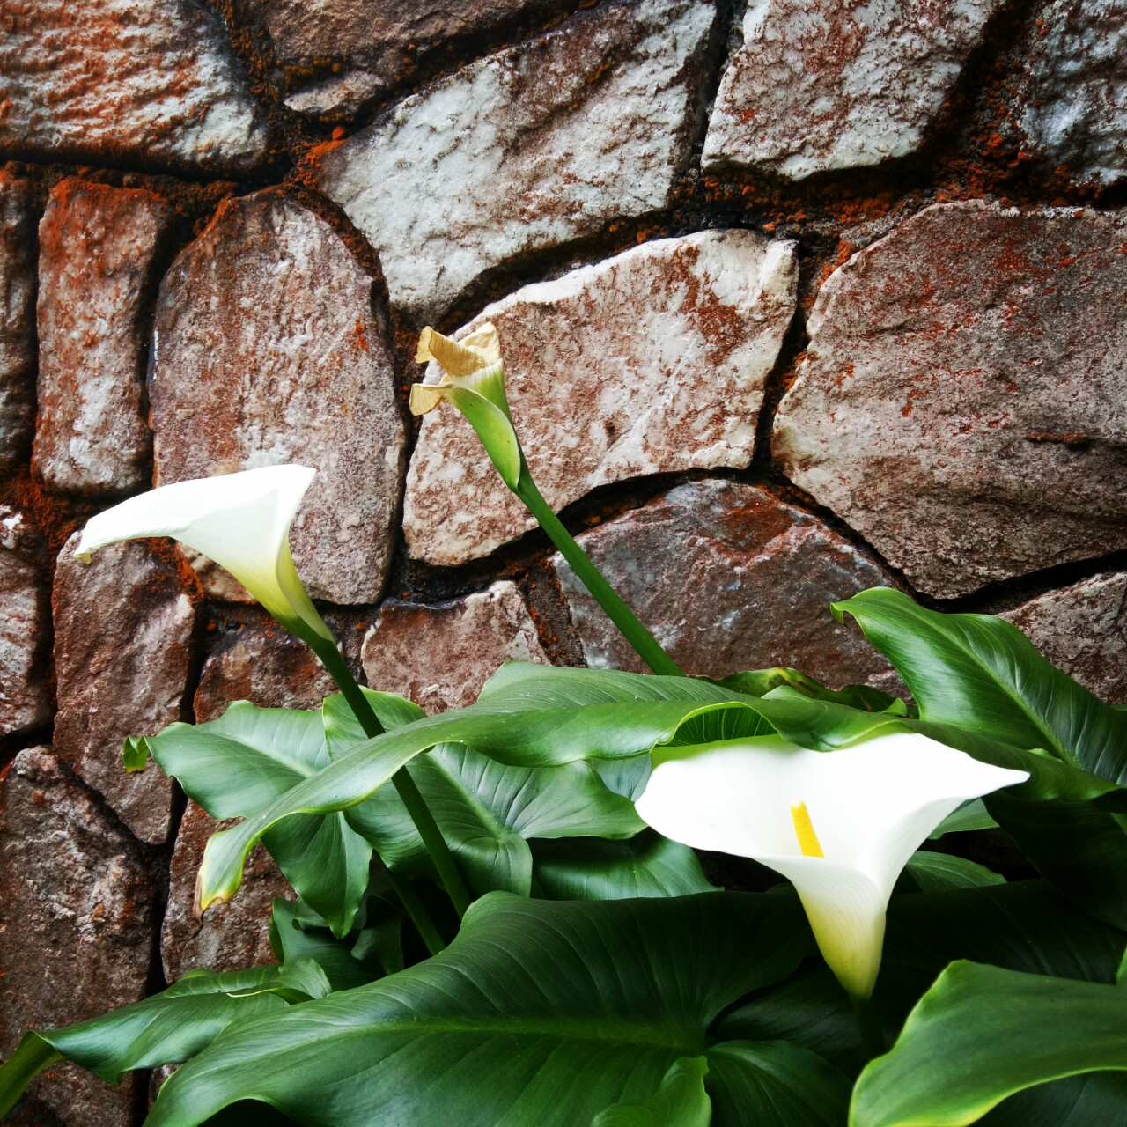
Meals arrangement
You can bring your own meals but dining is only allowed strictly in the dining hall downstair.
The pantry is available to heat up your food or boil some drinking water.
Food orders @ campsite have to be made in advance upon your booking. RM10 for B/F, RM20 each for lunch & dinner.

Slide 10
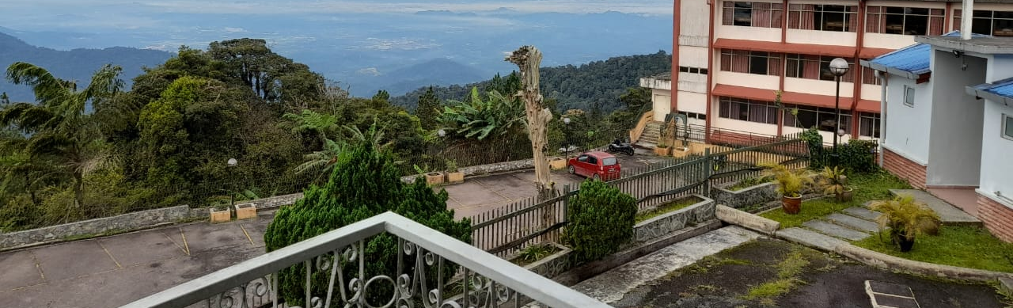
Focus on praying for the NATION!
@ WORSHIP with songs and praises
@ Read & declare the WORD of God
@ WAIT in meditation and the move of God
@ WRESTLE in prayer

Slide 11

NECF Office: 03-77278227
Call us should you need any clarification, further information or explanation.
Thanks in advance for being the partners to build the National Prayer Altar @ Peacehaven, Genting Highlands!

